Slide 1
Top Song Analysis - Spotify
Multivariate Analysis
Group Members
-Amit Phadke
-Apurva Sarode
-Renuka Madhugiri

Slide 2
Problem Statement
Every year Billboard releases the list of top tracks. The judging is based on the amount of times the song was played on media platforms, The sales it made, its popularity among the people and its review by critics.
As time passes by the definition of a hit single changes. In the 1960s it was the smooth jazzy sound of Frank Sinatra and in late 2016 it was the high-pitched vocals of Justin Beiber.
A few questions arise,
Is there common factor that make these songs a hit? and if so, What are these factors?
How do our preferences change as time goes by?
Can we analyze the data to understand why songs go to the top of the charts?
Answering these questions might help our target audiences namely music artists and record labels.

Slide 3
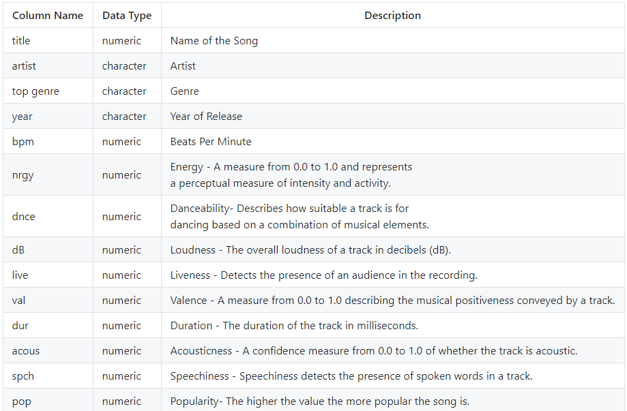
About the Dataset
The dataset we will be using for the project is sourced from Kaggle. It consist of the top tracks of every year since in 2010 from Billboard.com
The songs have some basic attributes such as Name, Artist Name, Release Year and Genre. Some important attributes that follow are a few music properties curated by Spotify. The properties include Danceability, Valence, Energy, Beats Per Minute etc.
In Summary, the Dataset contains 15 columns which include the song metadata and its audio properties. A total of 604 songs have been collected since the year 2011 which are a part of the top tracks list of Billboard.com. A detailed description of the fields is given below.

Slide 4
SPAP
Look for the common factor between top songs to predict future top tracks.
SMART GOAL
Dependent Variables
New attribute Rank will be dependent on the popularity attribute. Based on the mean of the popularity i.e. 67 , we can say that rating can be below average/above average .
Specific Questions?
Is there anything common between audio properties?
Does popularity of genre change according to year?
Does duration affect the popularity?
Independent Variables
“BPM”
“Year”
“Duration”
Analysis & Graph
Heat Map & Histogram
To find if there is any correlation between the audio properties.
Pie Chart
Year wise distribution of the popular Genre.
Line Chart
Scatterplot with variable Duration and popularity

Slide 5
Data Cleaning
Found missing data. Audio property bpm and column population contains null values so removing it.
Reordering the columns as it will be useful while preparing o combine column data or to rearrange columns after splitting column data.
Column Speechiness includes podcast and speeches and the values are low and inaccurate hence removing speechiness.
Also, column Liveness includes lives shows which are also inaccurate to test songs in a recording studio, hence removing Liveness.
The total number of rows and columns where 603 and 15, after cleaning it is 598 and 13.
Renaming the column names for better understanding of the Data.
Column Loudness contains scaling from -62 to 0 hence, scaling the data from 0 to 100 using min max.
For EDA purpose we created column Rating which has 2 labels as above average and below average using column popularity.

Slide 6
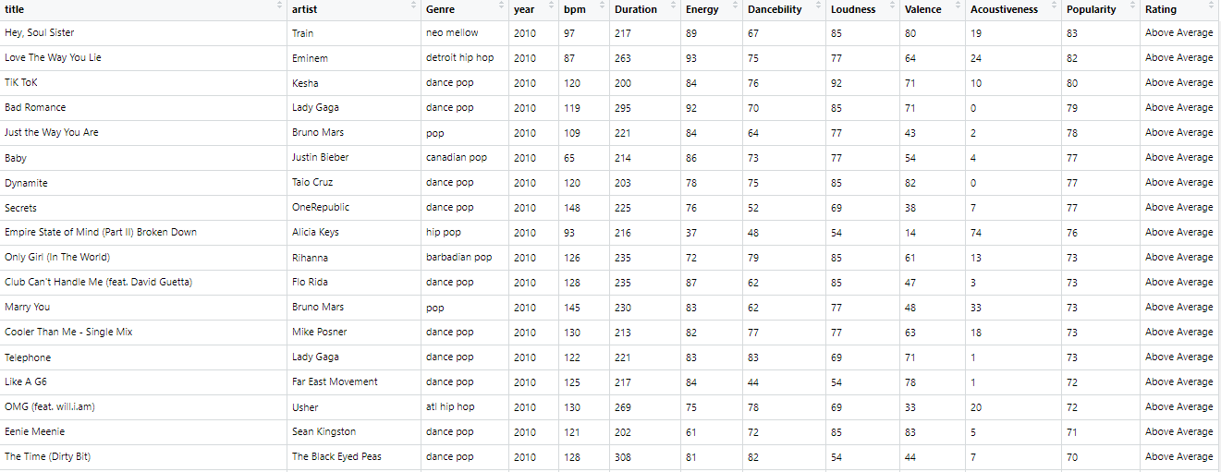
Cleaned Data
Data <- read.csv("C:\\Users\\Apurva Sarode\\Desktop\\Spotify_mva.csv",header = TRUE)

Slide 7
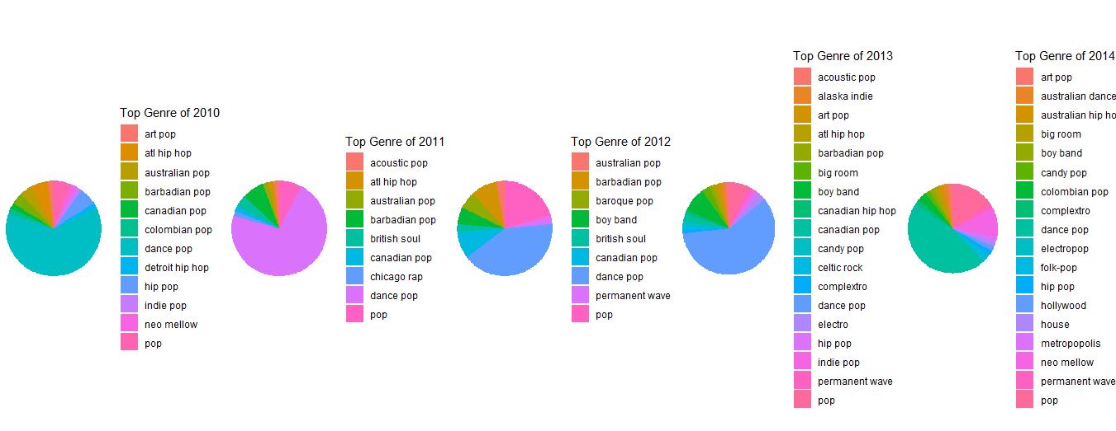
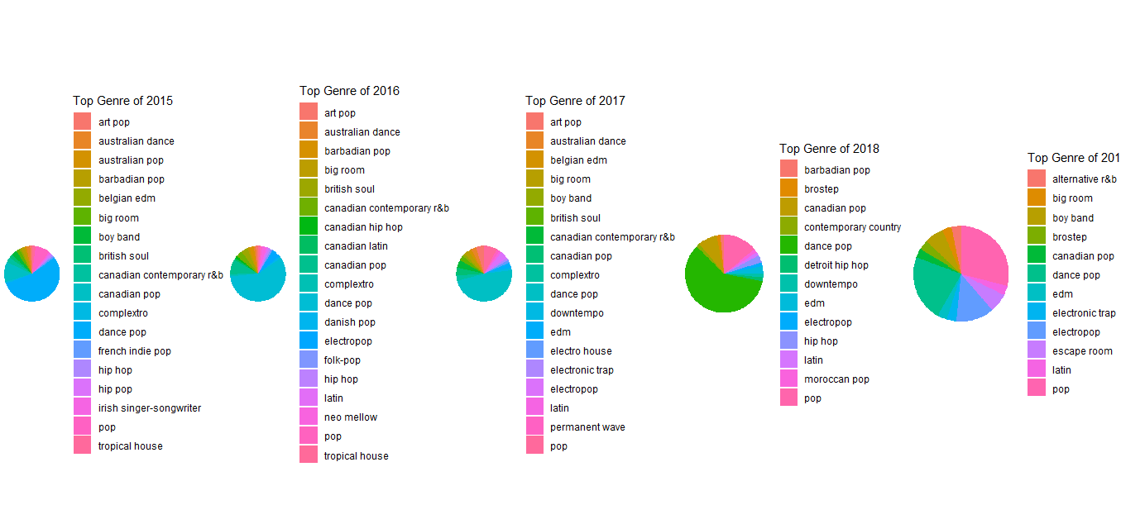
EDA – Top Genres

Slide 8
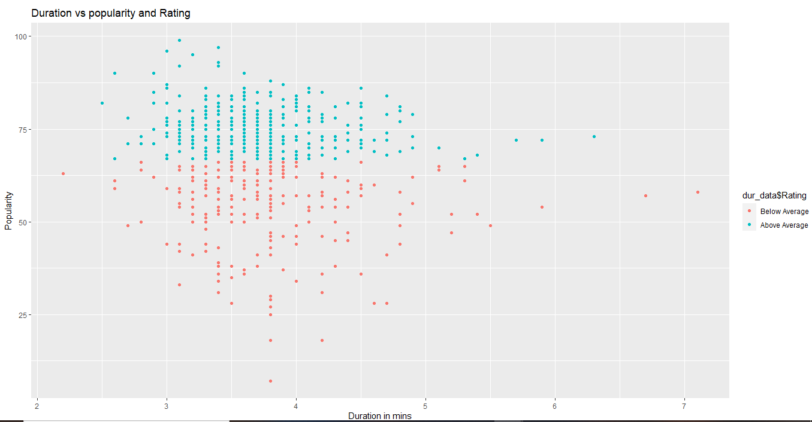
EDA – Song Duration

Slide 9
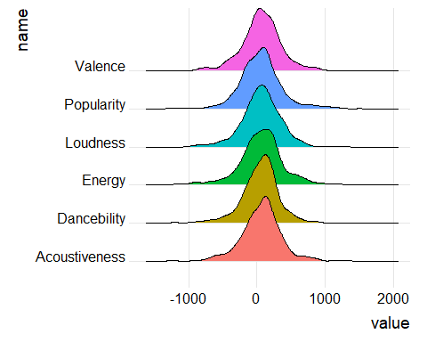
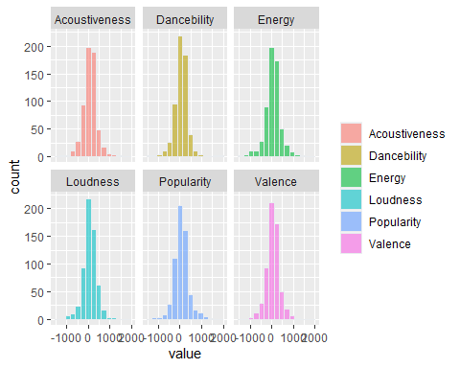
EDA – Audio Properties

Slide 10
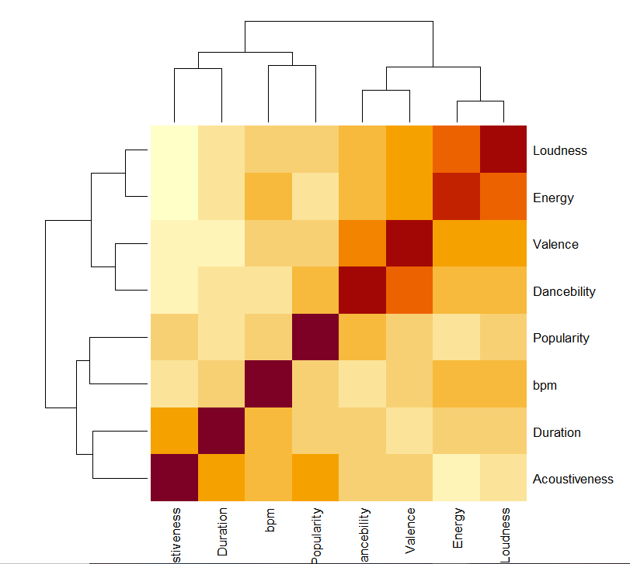
EDA – Heat Map

Slide 11
Exploratory Data Analysis
On doing Exploratory data analysis, we made the following observations:
In 2010, the genre that had the most number of popular tracks belongs to Dance pop. This was the case up to 2015. Post 2015, more classical pop songs started to gain popularity and by 2019 pop became the highest.
As per the duration of the song almost all tracks lie between 3 to 4.5 minutes. Only a few tracks go up to 7-minute mark.
For the audio properties of a song, the average for Danceability, Energy, Loudness and Valence is higher than that of Acoustiveness.
In HeatMap, we can see that Danceability and Valence has highest correlation as well as Energy and Loudness.

Slide 12
Statistical Testing
Using Statistical Testing we can see that there is a correlation between Danceability and Valence, Energy and Loudness.
T-test on Duration and Popularity Column give p-value <2.2e-16 which is very less , hence we can reject Null Hypothesis.
Checking T-test on columns Energy and Valence, Valence and Danceability, Energy and Acoustiveness. Based on the values we can see that it has low p-value, hence we reject Null Hypothesis for all the audio properties.
Also, checking T-test between dependent variables and independent variable i.e. Popularity and Duration, Popularity and Energy, Popularity and Danceability, Popularity and Loudness, Popularity and Valence, Popularity and Acoustiveness. Based on the values we can see that it has low p-value, hence we reject Null Hypothesis stating that there is significant relationship between them.

Slide 13
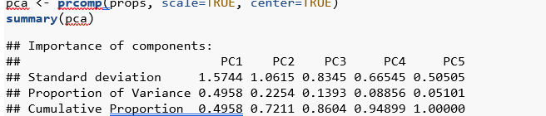
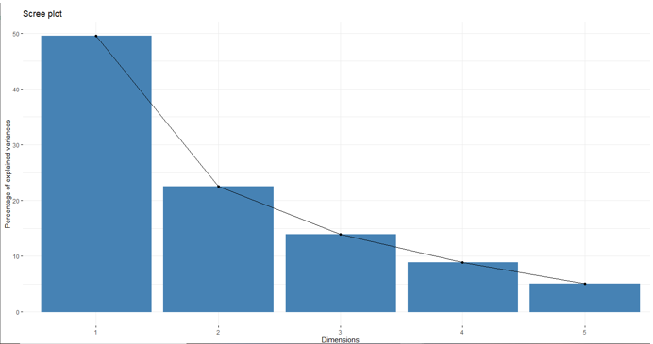
PCA
Previously, we saw that there is correlation between popularity and other variables was low, so we tested if our audio properties are correlated.
We can see from the PCA output that PC1, PC2 and PC3 has variance of around 84%.
On Plotting Screeplot, we can prove that PC1, PC2 and PC3 has cumulative variance of 84% and its hence we will be selecting first three components for our analysis.

Slide 14
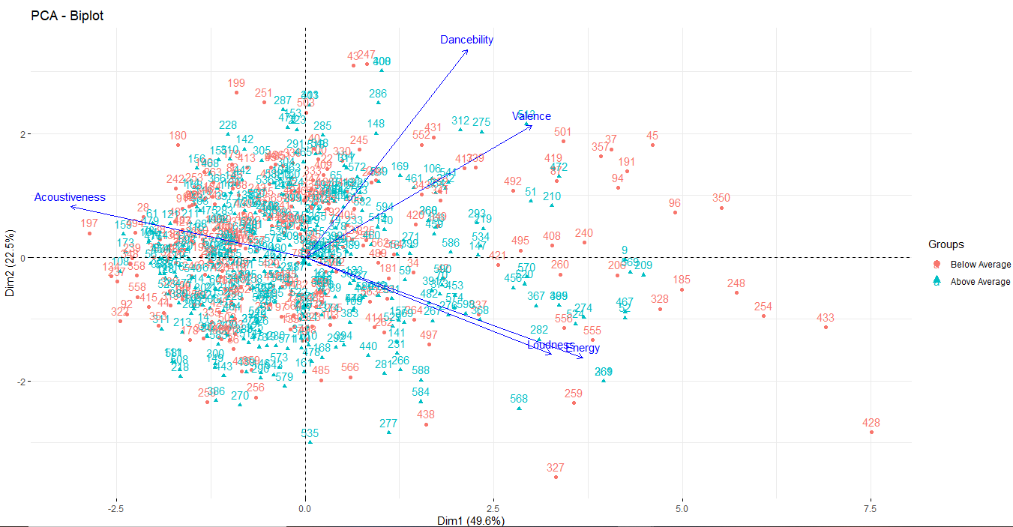
PCA – BiPlot
Using Biplot we could see that Acoustiveness and energy, loudness have inverse relationship. i.e if Acoustiveness is high then energy and loudness are low and vice versa.

Slide 15
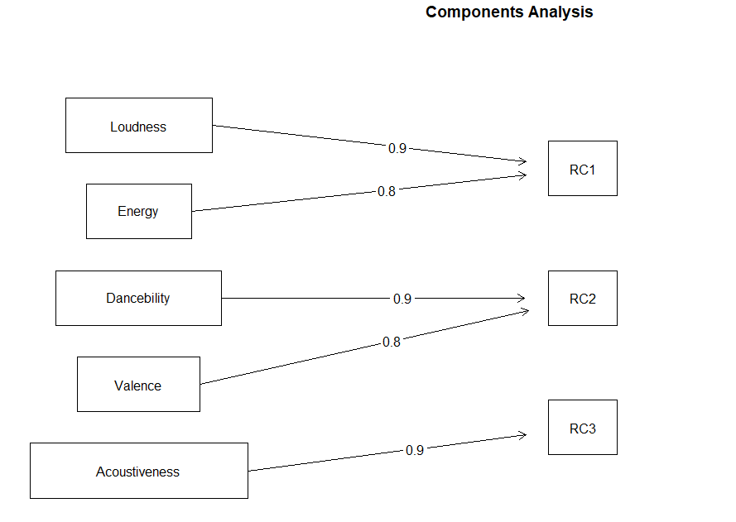
Factorial Analysis
From the below visualization we could see that there is a loss of 30% in RC1 from factors Loudness and Energy, the same can be seen between Loudness and Energy for RC2. Also, there is a loss of 10% in RC3 from Acoustiveness. Hence, we can conclude that there is some behavioral similarities between the factors like Loudness and energy, Danceability and Valence, Acoustivesness. This Analysis can further help in our cluster Analysis.

Slide 16

Clustering
Using function nb_clust we can say which is the best number of cluster for our analysis.
nb_clust = NbClust(Data_num, distance="euclidean", method = 'kmeans')

Slide 17
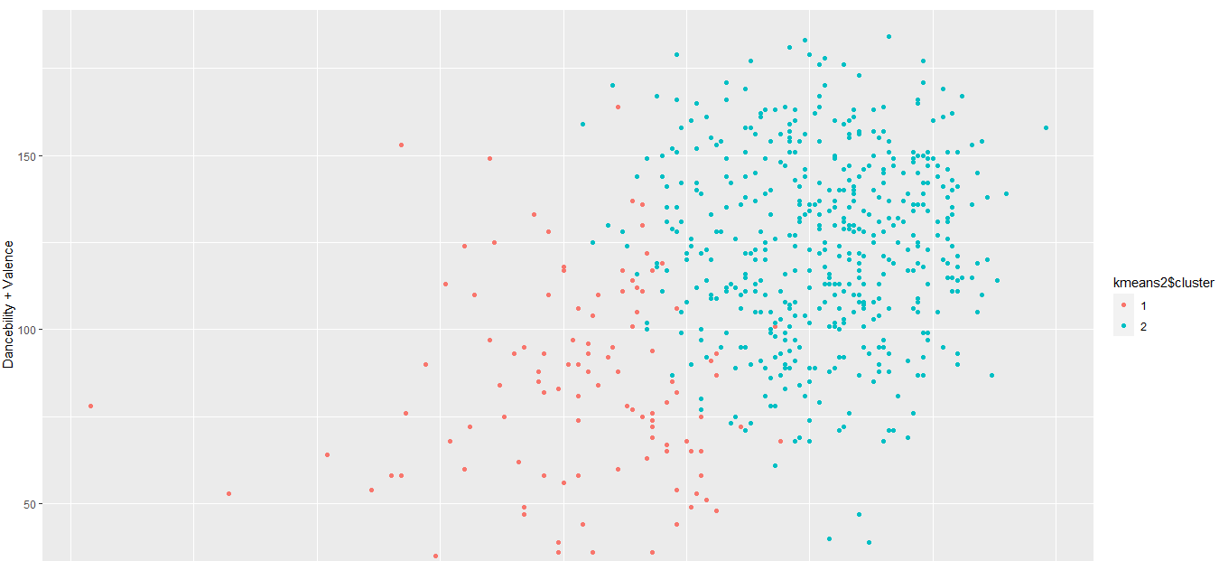
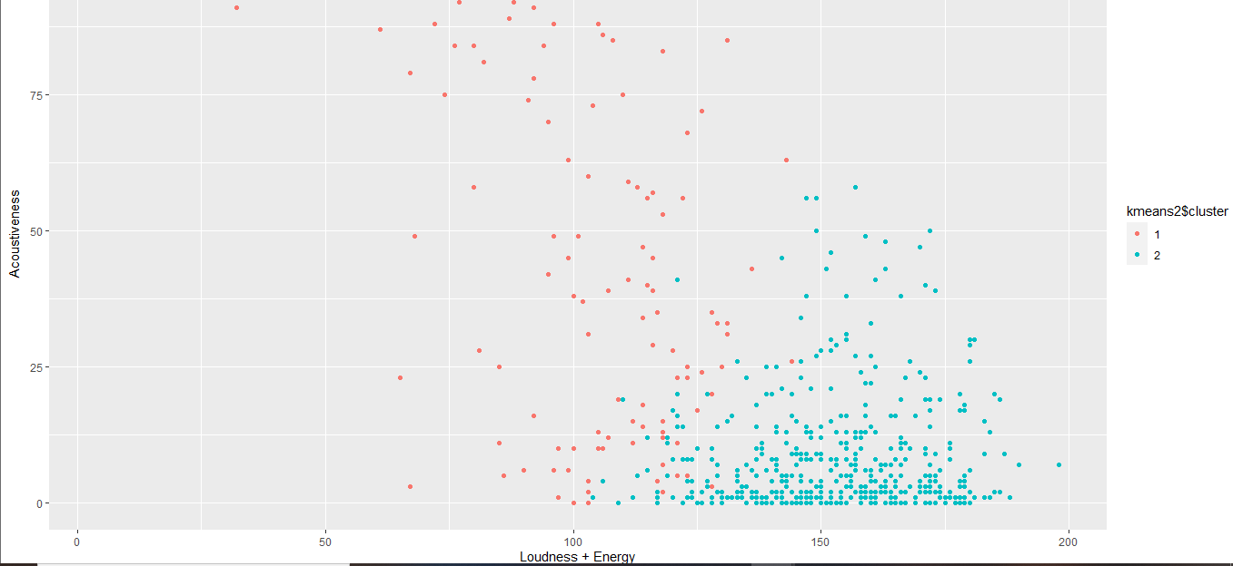
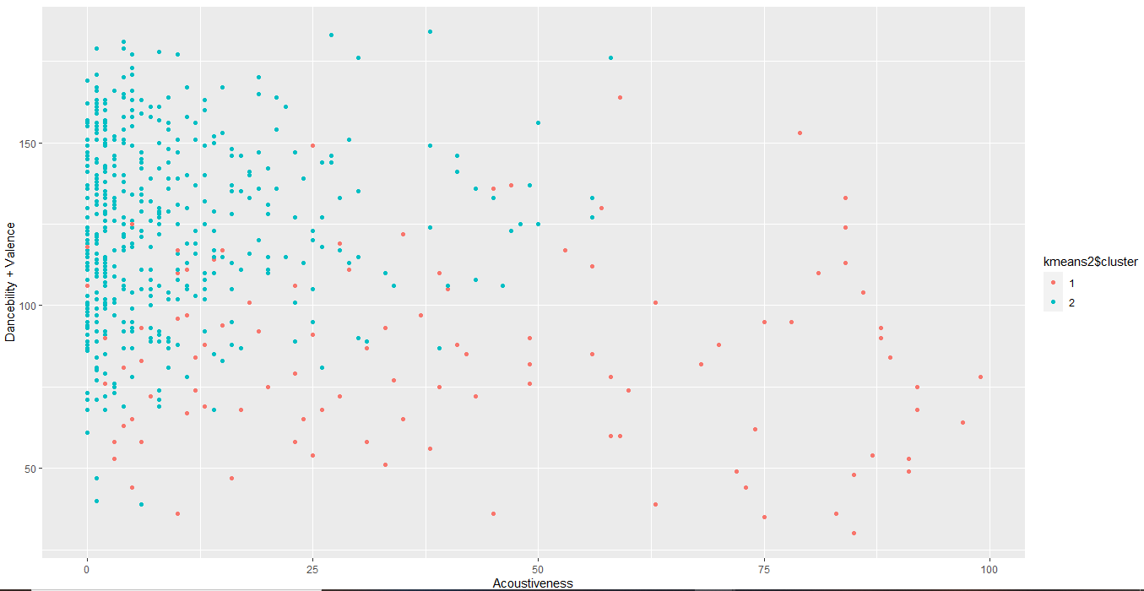
Clustering - Scatterplot
We can visually plot the 2 clusters.
Run the kmeans algorithm on the standardized data with K=2.
We could see that their forms clustering with low acoustiveness and high Loudness+Energy.
Also, clustering with high Loudiness+Energy and high Danceability+Valence.
Lastly, there is clustering with low acoustiveness and high Danceability and Valence.

Slide 18
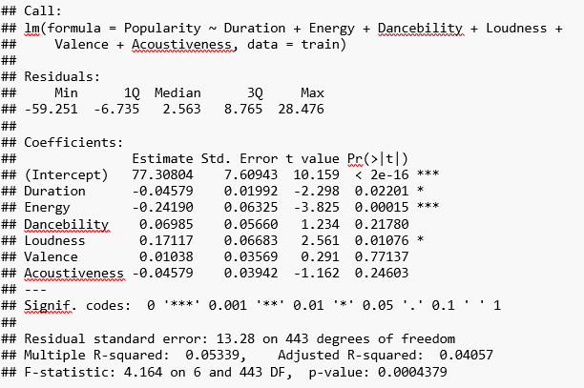
Multiple Linear Regression
fit<- lm(Popularity~Duration+Energy+Dancebility+Loudness+Valence+Acoustiveness,data = train) summary(fit)
On observing we could see for the whole model, that the Adjusted R-squared value and P-value is low. Thus, Linear Regression does not fit for the whole model as the Adjusted R-squared value is very less.

Slide 19
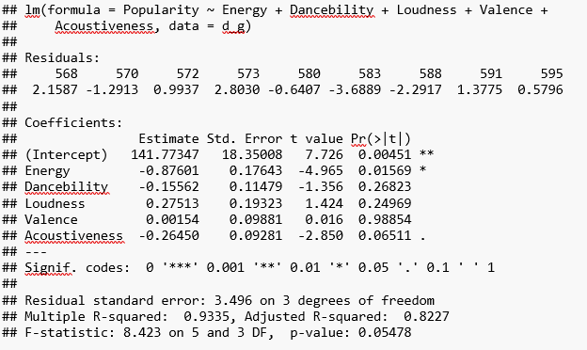
Multiple Linear Regression
d_g = Data[Data$Genre == 'pop' & Data$year == c(2019),c(4,7:13)] ft_g = lm(Popularity~Energy+Dancebility+Loudness+Valence+Acoustiveness, data= d_g) summary(ft_g)
On selecting genre as ‘pop’ for year 2019, we can see that the Adjusted R-square is high, and the p-value is low. Based on the audio properties, may be we can predict the popularity based on the genre of a particular year.

Slide 20
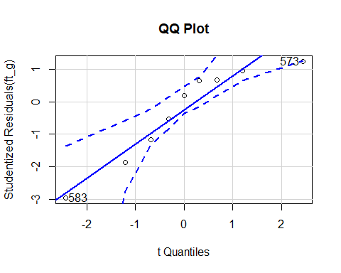
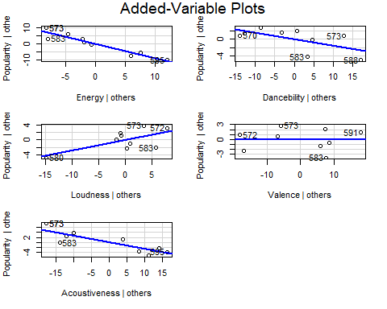
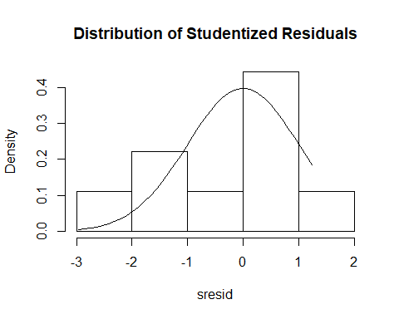
Multiple Linear Regression
fc_g= predict.lm(ft_g,data.frame(Acoustiveness=32,Loudness = 62,Dancebility=64,Valence=59,Energy=70)) fc_g
Output:- 79.17777
From the first plot i.e Q-Q plot we could see that the point lie inside the Outliers.
The second plot show the value of each predictor after other predictors are accounted for on the X-axis and the value of the dependent variable after other predictors are accounted for on the Y-axis.
From the third plot we could see that the points are normally distributed and most of them lie between 0 and 1.

Slide 21
Conclusion
As per our questions of this analysis we came to following conclusions:
Almost all these top tracks had a low acoustiveness ,high loudness and energy and moderate-high valence and danceability.
Most of the top songs have duration of 3 to 4.5 minutes.
Music preferences do change over the decade as we have observed in EDA
By analyzing the data we can conclude that songs can be divided into clusters based on the behavior of their audio properties

Slide 22
THANK YOU

